Slide 1


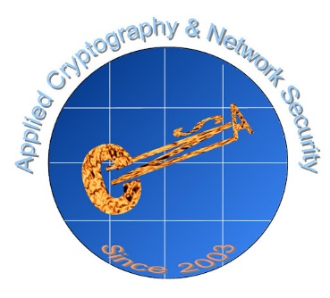
When TLS Meets Proxy on Mobile
Joyanta Debnath¹, Sze Yiu Chau², and Omar Chowdhury¹
¹ The University of Iowa
² The Chinese University of Hong Kong
ACNS’20

Slide 2






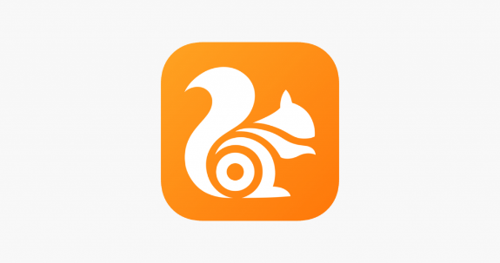



Proxy-based Mobile Browsers
Data Compression
Geo-blocking Bypass
Censorship circumvention
Browser
Proxy Server
Remote Server

Slide 3




Research Question
When TLS is in place
Browser
Proxy Server
Remote Server
What are the security implications of
proxy-based mobile browsers ?

Slide 4
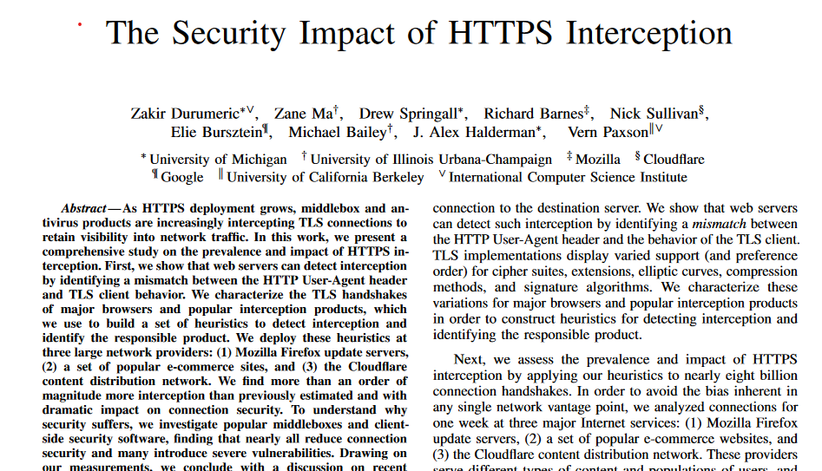
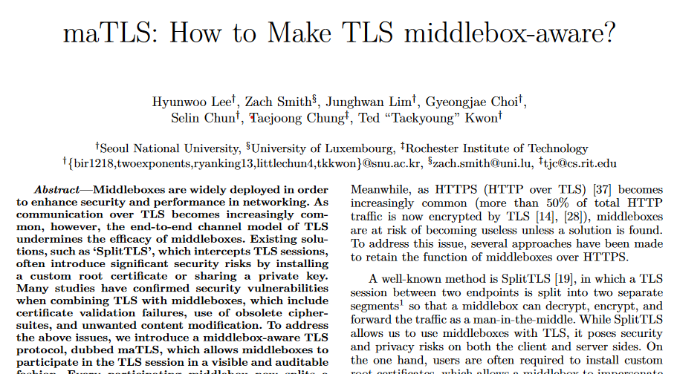
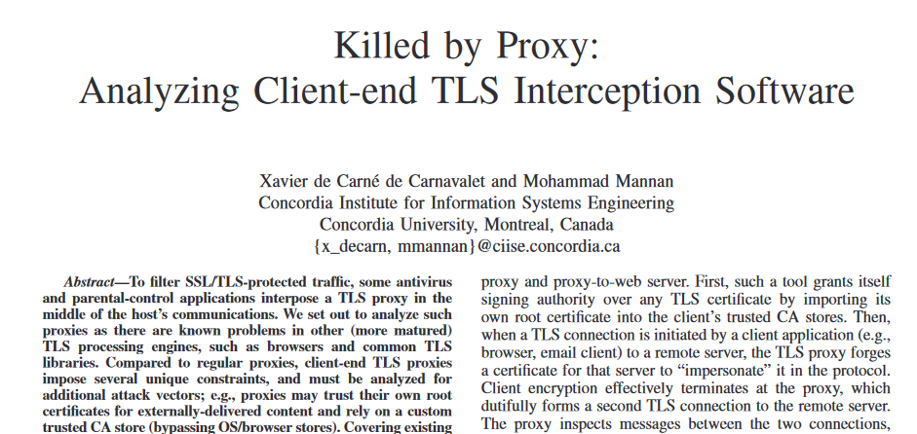
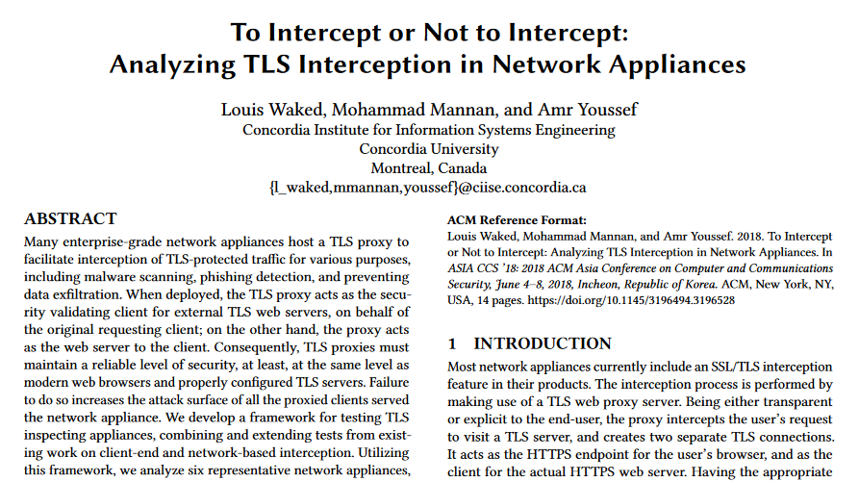
Related Works

Slide 5
Contributions
One of the first studies on security implications of proxy-based mobile browsers
Automated experimental framework
Found security vulnerabilities in most of the proxy-based mobile browsers

Slide 6
Outline
Motivation & Contributions
Background
Experimental Setup
Security Evaluations
Results
Recommendations
Summary

Slide 7


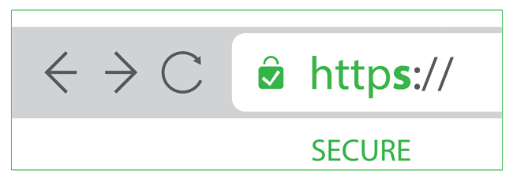
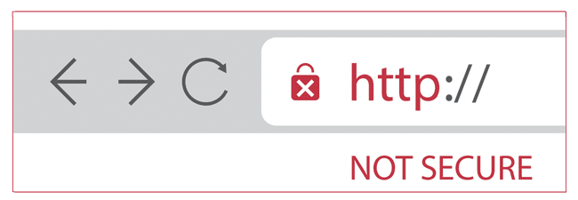
Background : Transport Layer Security
Untrusted Network
Browser
Browser
Remote Server
Remote Server
Browser
Remote Server
ClientHello
ServerHello, Certificate, ServerHelloDone
Other Handshake Messages
Application Data

Slide 8
Background : Establishing Proxy-server Connection
How do proxy-servers handle TLS?
TLS Interception (TI)
HTTP Tunneling (HT)
Breaks
end-to-end security
Creates a tunnel between browser and remote server

Slide 9

Background : TLS Interception
Browser
Proxy Server
Remote Server
ClientHello
ClientHello
Two separate TLS sessions
ServerHello, Certificate, ServerHelloDone
ServerHello, Certificate, ServerHelloDone
Other Handshake Messages
Other Handshake Messages
Application Data
Application Data

Slide 10
Background : HTTP Tunneling
Connect *.com: 443 HTTP/1.1 Host *.com: 443
HTTP 200 OK
Browser
Proxy Server
Remote Server
ClientHello
Two separate TCP connections, but one TLS session
ServerHello, Certificate, ServerHelloDone
Other Handshake Messages
Application Data

Slide 11
Outline
Motivation & Contributions
Background
Experimental Setup
Security Evaluations
Results
Recommendations
Summary

Slide 12




Experimental Setup : Overview
Wireshark
Internet
Proxy Server
WiFi Hotspot
Wireshark
Select Proxy-server/ Enable Data-saving feature
Browser
Remote Server

Slide 13
Experimental Setup : Browser Selection
34 proxy-based mobile browsers
Highly automated heuristic-based proxy-server
identification and classification algorithm
Section 3.3 for details
16 TI Browsers
18 HT Browsers
Browser

Slide 14
Experimental Setup : Browser Selection
Aloha Browser
Aloha Browser Lite
Google Chrome
Opera
Opera Beta
Opera Mini
Opera Mini Beta
Puffin Browser
Private Browser
Tenta Browser
Tunnel Browser
Unblock Website
UPX Browser
X Web Proxy
BROXY Browser
UC Mini
Arvin Browse
Blue Proxy Browser
Browser for Android
Unblock Smart Browser
Ghost Browser
Hola Browser
JAV pekob
BProxy Browser
Proxybro
Proxyfox Browser
Proxynel Browser
Super Browser
Unblock Site Browser
Unblock VPN Browser
Unblock Websites
Unlocker Sites
VPN Proxy Browser
Web Proxy Browser
TI Browsers
HT Browsers

Slide 15
Security Evaluations : TI Browsers
Certificate Parameters
TLS versions
Cipher Suites
Certificate Validation
Strength of TLS sessions
≈?
Browser
Proxy Server
Remote Server

Slide 16
Security Evaluations : TI + HT Browsers
Certificate Validation
Weak Cipher Suite
Weak TLS Version
Browser
Blocks connection / Shows warning ?

Slide 17
Outline
Motivation & Contributions
Background
Experimental Setup
Security Evaluations
Results
Recommendations
Summary

Slide 18
Results : TI Browsers
Proxy-servers do not maintain symmetry in TLS sessions
Fixed TLS version ( e.g., TLSv1.2 ) or cipher suites in proxy-to-browser TLS session
Fixed certificate parameters in proxy-signed certificate
( e.g., SHA256 signature hash algorithm, RSA-2048 bits public key )
A false sense of security
Users do not see proxy-to-remote TLS session !
Browser
Proxy Server
Remote Server

Slide 19
Results : TI Browsers
RSA Public key size for UPX browser’s proxy-signed certificate = 1024 bits !
National Institute of Standards and Technology (NIST) recommends RSA key >= 2048 bits

Slide 20
Results : TI & HT Browsers
Browsers or proxy-servers do not prohibit weak ciphers
Support for 3DES encryption algorithm (34/34)
Support for MD5 hash algorithm (3/34)
Support for RC4 encryption algorithm (3/34)
Support for SHA1 hash algorithm (34/34)
No warning is shown to user

Slide 21

Results : TI & HT Browsers
UC Mini browser (100,000,000+ downloads)
supported RC4 encryption algorithm
and MD5 hash algorithm till 2019 !

Slide 22
Results : TI & HT Browsers
Browsers or proxy-servers do not validate certificate chains properly
No certificate revocation status check (32/34)
No certificate expiry date check (7/34)
No common name check (8/34)
No certificate validation at all (4/34)
No warning is shown to user

Slide 23
Results : TI & HT Browsers
All 34 Browsers or proxy-servers still support weak TLSv1 !
BEAST, SLOTH
Proxy-servers of UC Mini browser till 2019 in data-saving mode
TLSv1.2
SSLv3 / TLSv1
Browser
Proxy Server
Remote Server

Slide 24
Results : Summary
Leniency in Certificate Validation
Asymmetry of TI Browsers
Usage of weak Cipher Suites
Usage of weak Certificate Parameters
Usage of weak TLS Versions
TLS is severely downgraded in most of the proxy-based mobile browsers
November 2018 – October 2019
34 Browsers

Slide 25
Recommendations
Validate certificate chain properly
Check strength of certificate parameters
Disable weak and deprecated TLS versions & Cipher Suites
Block weak TLS sessions, or show warning to user
Proxy Server
Browser

Slide 26
Responsible Disclosure
Reported findings to browser vendors
Received reply from 6 vendors only
Findings acknowledged by 4 vendors
Rejected by 2 vendors due to backward compatibility issues

Slide 27




Summary
Explored security implications of proxy-based mobile browsers
Developed a highly automated experimental framework
Found security vulnerabilities in most of the proxy-based mobile browsers
Reported findings to the browser developers

Slide 28
Website : https://sites.google.com/view/joyantadebnath/when-tls-meets-proxy-on-mobile
Source Code : https://github.com/joyantaDebnath/When-TLS-Meets-Proxy-on-Mobile

Slide 29
THANK YOU

